Slide 1
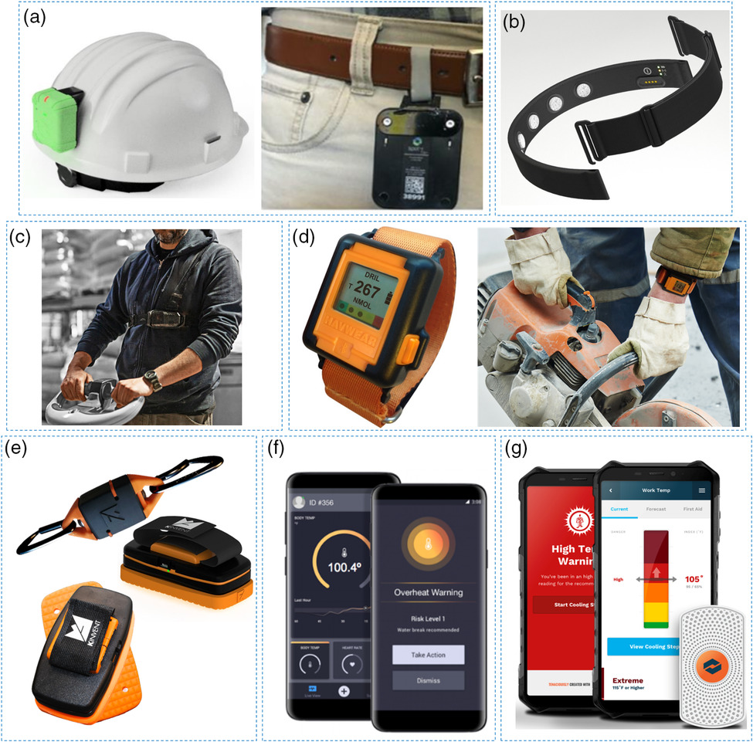
Trends in Workplace Wearable Technologies and Connected‐Worker Solutions for Next‐Generation Occupational Safety, Health, and Productivity
Figure 2: Examples of wearables for occupational safety monitoring. a) The Triax Proximity Trace consists of TraceTags affixed to hard hats for monitoring safe working distance and interactions. b) The SmartCap LifeBand measures brain waves to estimate alertness and fatigue levels at work. c) The StrongArm ErgoSkeleton Lift Assist helps with heavy lifting by transferring the load from the upper body and back to the legs. d) Reactec HAVwear is designed for the risk management of hand arm vibrations and provides real-time safety analytics and alerts. e) K-invent dynamometers consist of force transducers with biofeedback to evaluate muscle strength and endurance. f) Kenzen's personalized app and smart PPE enable the continuous safety monitoring of workers by tracking the microclimate, core body temperature, heart rate and exertion. g) The Corvex Temperature Management platform monitors the work temperature of frontline workers, providing them with situational awareness and data transparency.
Advanced Intelligent Systems, Volume: 4, Issue: 1, First published: 23 September 2021, DOI: (10.1002/aisy.202100099)
Notes:
Examples of wearables for occupational safety monitoring. a) The Triax Proximity Trace consists of TraceTags affixed to hard hats for monitoring safe working distance and interactions. b) The SmartCap LifeBand measures brain waves to estimate alertness and fatigue levels at work. c) The StrongArm ErgoSkeleton Lift Assist helps with heavy lifting by transferring the load from the upper body and back to the legs. d) Reactec HAVwear is designed for the risk management of hand arm vibrations and provides real‐time safety analytics and alerts. e) K‐invent dynamometers consist of force transducers with biofeedback to evaluate muscle strength and endurance. f) Kenzen's personalized app and smart PPE enable the continuous safety monitoring of workers by tracking the microclimate, core body temperature, heart rate and exertion. g) The Corvex Temperature Management platform monitors the work temperature of frontline workers, providing them with situational awareness and data transparency. The figures were reproduced with permission: a) Reproduced with permission.[61] Copyright 2021, Triax; b) Reproduced with permission.[118] Copyright 2021, SmartCap; c) Reproduced with permission.[45] Copyright 2021, StrongArm; d) Reproduced with permission.[62] Copyright 2021, Reactec; e) Reproduced with permission.[139] Copyright 2021, K‐invent; f ) Reproduced with permission.[82] Copyright 2021, Kenzen; and g) Reproduced with permission.[230] Copyright 2021, Corvex.
IF THIS IMAGE HAS BEEN PROVIDED BY OR IS OWNED BY A THIRD PARTY, AS INDICATED IN THE CAPTION LINE, THEN FURTHER PERMISSION MAY BE NEEDED BEFORE ANY FURTHER USE. PLEASE CONTACT WILEY'S PERMISSIONS DEPARTMENT ON PERMISSIONS@WILEY.COM OR USE THE RIGHTSLINK SERVICE BY CLICKING ON THE 'REQUEST PERMISSIONS' LINK ACCOMPANYING THIS ARTICLE. WILEY OR AUTHOR OWNED IMAGES MAY BE USED FOR NON-COMMERCIAL PURPOSES, SUBJECT TO PROPER CITATION OF THE ARTICLE, AUTHOR, AND PUBLISHER.

